Slide 1


Grant Reform: The Super Circular Explained - Everything You Need To Know
ANÍBAL JOVER PAGÉS, CPA, CGMA
Anthony D. Cruz Aldecoa, CPA

Slide 2
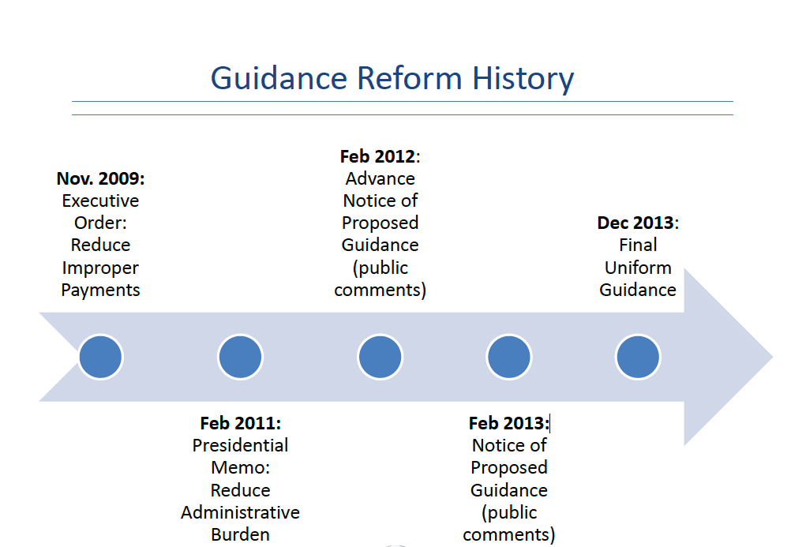
GUIDANCE REFORM HISTORY

Slide 3
What is the Uniform Guidance (UG!)?
OMB’s consolidation of circulars for costing, administration and audit of Federal awards
  2 CFR 200 replaces 8 circulars and applies to universities, state and local governments, nonprofits, native tribes
  Issued on December 26, 2013
  Effective largely on December 26, 2014
Biggest change in Federal regulations in 50 years
Some good news, some new administrative burdens
Each Federal agency will implement a slightly different version of the UG
UG is still being interpreted and clarified

Slide 4
What are the high level goals of the Omni-Circular?
Streamline guidance on federal awards Reduce administrative burden for the government
Strengthen federal oversight of funding, to reduce potential for waste, fraud and abuse.
Set standard requirements for financial award management uniformly across all federal agencies
Locate all OMB Circulars into Title 2 of the CFR (i.e. – consolidation of 8 OMB Circulars into Title 2 of the CFR)
Increase efficiencies and effectiveness of Federal Award making (i.e.- best use of funds)

Slide 5
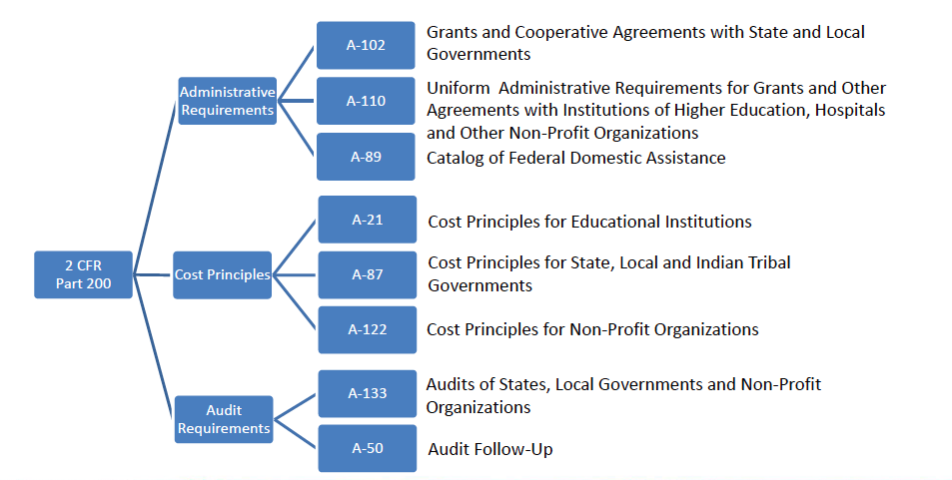
CODIFICATION OF EIGHT OMB CIRCULARS

Slide 6
Organization of the Omni-Circular, 2 CFR Part 200 Uniform Guidance
Subpart A – Acronyms & Definitions
Subpart B – General Provisions (Section 200.1xx)
Subpart C – Pre-Award Requirements (Section 200.2xx)
Subpart D – Post Award Requirement (Section 200.3xx)
Subpart E – Cost Principles (Section 200.4xx)
Subpart F – Audit Requirements (Section 200.5xx)
TERMS TO REMEMBER:
  “Must” means “Required”
  “Should” means not required but is best practice
  “Pass-Through Entity” is Prime Recipient

Slide 7
Organization of the Omni-Circular, 2 CFR Part 200 Uniform Guidance, cont’d
Appendix I – Full text of the Funding Opportunity Notice
Appendix II – Contract provisions for non-fed entities
Appendix III – F&A Identification and assignment for Higher-Ed (Indirect Cost Identification & Assignment, Rate Determinations)
Appendix IX- Hospital Cost Principles
Appendix XI- Compliance Supplement
In total 11 Appendices- I through XI

Slide 8
Uniform Grant Guidance Effective Dates
Federal agencies (FA) must implement policies and procedures by promulgating regulations to be effective December 26, 2014.
  Non-federal entities will need to implement the new administrative requirements and cost principles for all new Federal awards made after December 26, 2014 and funding increments after that date where Federal agencies change award terms and conditions
    FAQ .110-6 - Effective Dates and Grace Period for Procurement.
    FAQ .110-7 – Effective Dates and Incremental Funding.
    NFE may implement entity-wide system changes to comply with the UG without penalty.
  Audit requirements effective for fiscal years beginning on or after December 26, 2014:
    No early implementation of audit provisions.

Slide 9
A Closer Look at Effective Dates
All 2014 year ends: No impact from the UG for NFE and auditors.
Quarters ending March 31; June 30; and Sept 30, 2015: NFE use new Administrative Requirements and Cost Principles for all new awards and funding increments with changed terms and conditions.
OMB Circular A-133 audit requirements remain.
NFE likely have awards subject to the old requirements and awards subject to the new requirements.
December 31, 2015, year-ends and beyond: New Single Audit requirements apply.

Slide 10
Conflict of Interest
§200.112 (NEW)
Requires Federal awarding agencies to establish a conflict of interest policy for Federal awards. The non-Federal entity must disclose in writing any potential conflict of interest to the Federal awarding agency or pass-through entity in accordance with applicable Federal awarding agency policy.
This refers to conflicts that might arise around how a non-Federal entity expends funds under a Federal award. These types of decisions include, for example, selection of a subrecipient or procurements as described in section 200.318.
Requires a disclosure to the awarding agency of potential conflicts of interest in accordance with that agency’s policy
Agencies implementation plans should be reviewed for additional guidance or requirements

Slide 11
Key Sections-Subpart C
200.201 Use of Grants (including Fixed Amount Awards)
Coop- Agreements and Contracts: (NEW)
Federal Agency must determine appropriate award instrument
Incorporates new guidance for fixed amount awards
    Payments based on specific requirements;
    Accountability based on performance & results;
    Award amount negotiated using cost principles as a guide;
    Significant changes require prior approval.
New guidance appears to imply that ‘accountability’ at the end of a fixed amount award, may require that the amount of the award be adjusted downward accordingly.
Conversation point: This could have impacts on when a program is run for less than was budgeted. Historically, the grant recipient could retain the residual. Perhaps no longer the case?

Slide 12
Key Sections – Subpart C
200.203 Notice of Funding Opportunities (NEW)
Specifies a set of 6 mandatory data elements (standardization)
Identifies the full text that must be included in funding opps, (Appendix I of Part 200)
Establishes minimum timeframe (60 days) that federal agencies must generally make funding opportunities available to applicants
Agencies must generally post opportunities at least 60 calendar days prior to due date, but… no opportunities should be available for less than 30 calendar days.
Talking point: This is a good move toward standardizing funding opps, and while 60 days lead time is not as good as 90, it is still an improvement

Slide 13
Key Sections – Subpart C
200.204 Federal Agency Review of Merit (NEW)
This is new requirement, and helps the small or middle size applicants understand the ‘playing field’
Federal agencies must design and execute merit review processes for applications
The merit review process must be described in the in the funding opp (i.e. - transparency to the applicant)
Talking point: This is a good addition that allows applicants to fully understand the merit review criteria, and review process.

Slide 14
Key Sections – Subpart C
200.205 Federal Agency Review of Risk
Federal agencies must have a framework for evaluating risks by applicants, prior to making awards.
Possible risk items considered by the agencies
  Financial stability
  History of performance
  Audit reports
  Applicants ability to implement effective systems
Conversation point: Importance of delivery of timely progress reports, having effective management systems implemented, etc. is amplified.

Slide 15
Risk Assessment of Applicant- Subpart C
Agency must perform risk assessment of awardees:
  Debarment List
  Do Not Pay List
  Federal Awardee Performance and Integrity Information System (FAPIIS) – past performance
  Dun and Bradstreet reports
  Prior audits
  Death Master File of SSA
  Debt Check Database of US Treasury
  Credit Alert System HUD
  Incarcerated individuals

Slide 16
Key Sections – Subpart C
200.210 Information Contained in a Federal Award
Provides a set of 15 standard data elements that must be provided in all Federal awards, and also flowed down in Subawards
Requires agencies to incorporate general terms and conditions
Conversation point: Clarification is being sought by the grants community regarding if the second point above refers to the Research and Related Terms

Slide 17
PERFORMANCE REPORTING
§200.301
Continued pressure from agencies to relate research progress to financial information and other “data” (e.g., number of students, publications, patents)
The Federal awarding agency must require the recipient to use OMB-approved governmentwide standard information collections when providing financial and performance information. The Federal awarding agency must require the recipient to relate financial data to performance accomplishments of the Federal award. Also, in accordance with above mentioned governmentwide standard information collections, and when applicable, recipients must also provide cost information to demonstrate cost effective practices (e.g., through unit cost data).
Guidance provides for research sponsors to use standard Research Performance Progress Report (RPPR) format – depends on agency implementation (NSF is on board!)

Slide 18
Key Sections – Subpart D
200.303 Internal Controls
Recipients required to have internal controls in place that comply with federal statutes and regulations
  Institutions and their auditors will need to review
COFAR offers the following source documents to be used as best practice, but are not prescriptively required
    “Standards for Internal Control in the Federal Government” (Green Book) issued by the Comptroller General. (Should Follow)
    “Internal Control Framework” issued by the Committee on Sponsoring Organizations (COSO)
    Appendix XI, Compliance Supplement – Part 6 Internal Control (which currently follows COSO but will consider both the Green Book and COSO in the 2015 update (200.514(c)(1))

Slide 19
Key Sections – Subpart D
200.306 Cost Sharing or Matching
Clarification is made that voluntary committed cost sharing is not expected under federal research proposal
Voluntary Committed Cost Share cannot be used as a factor during the merit review of the proposal
Cost Sharing may only be offered/considered when it’s required by regulation and transparently displayed in the funding opportunity
Conversation point: This is a great clarification that is similar to NSF’s policy on cost share.

Slide 20
Key Sections – Subpart D
200.307
PROGRAM INCOME (PI)
§200.307
Income from license fees and royalties on research funded by a Federal award should be excluded from the definition of program income. US law or statute takes precedent over the Uniform Guidance.
The guidance in section 200.400(g) states that the non-Federal entity may not earn or keep any profit resulting from Federal financial assistance, unless expressly authorized by the terms and conditions of the Federal award.
If the Federal agency does not specify in its regulations or the terms and conditions of the Federal award how program income is to be used, the Addition method must apply. When the Federal awarding agency authorizes the Addition method or Cost sharing or matching, program income in excess of the amounts specified must also be deducted from expenditures.
The default to the Addition method for IHEs and nonprofit research institutions standardizes this practice. Under A-110, standard use of the Addition method for IHEs and nonprofit research institutions is not specified as the default.

Slide 21
Key Sections – Subpart D
200.308
§200.308
Revision of budget
For non-construction Federal awards, recipients must request prior approvals from Federal awarding agencies for one or more of the following program or budget-related reasons:
  The disengagement from the project for more than three months, or a 25 percent reduction in time devoted to the project, by the approved project director or principal investigator
New language added to reflect that project directors can be away from campus and remain engaged in the project at the proposed and awarded levels.
“Disengagement” from the project for more than three months, rather than “absence” from the project (A-21).
Notes:
PI can still work off site and be considered engaged in the project – they don’t have to physically be present.

Slide 22
Key Sections – Subpart D
200.313 Equipment
Property records must contain percentage of federal participation in the project costs for the federal award that the equipment was purchased. Very Confuse
Property records must contain the “use” of the equipment 200.313 (d) (1)
Subpart also includes disposition rules
Talking point: The guidance isn’t entirely clear, and adds a layer of record keeping elements that for example may need to modify in its tracking systems for non-Federal entities (NFE).

Slide 23
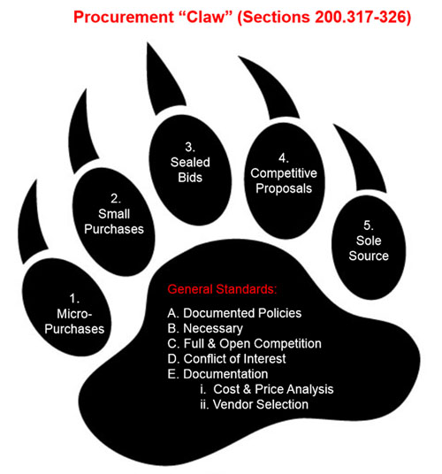
Procurement Standards - NEW
Notes:
5 Methods of Procurement

Slide 24
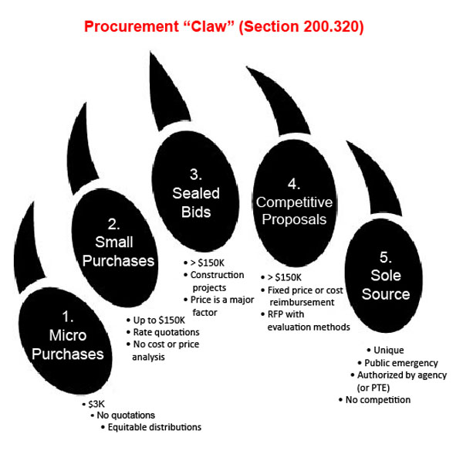

Slide 25
COMPETITION
§200.319
The non-Federal entity must conduct procurements in a manner that prohibits the use of statutorily or administratively imposed state or local geographical preferences in the evaluation of bids or proposals, except in those cases where applicable Federal statutes expressly mandate or encourage geographic preference.
This could create conflict for public universities required to follow State Statute
Notes:
We are still trying to determine what the effect this will have on the University procurement process. We have not received any clarification on this one from COFAR or the State of Missouri.

Slide 26
Methods of Procurement
§200.320
A prescriptive list of 5 procurement methods are provided
New category of “micro-purchase” which appears to allow purchases of up to $3,000 without competition
Small purchases over $3,000 would rate quotations – at least two
Concern: This could have implications on procurement card programs and bid thresholds. The current threshold on P-Cards is $5,000
COFAR issued FAQ granting a 1-year grace period to review additional options for implementation.
Notes:
The Controller’s office and sponsored programs offices will be working with procurement offices to determine how we will need to proceed and determine what policies need to be updated based on the changes.
Show-me Shop may be an option for those purchases over $3,000.

Slide 27
Subrecipient Monitoring
§200.330 Vendor vs. subrecipient classification
  Clarification that pass-through entity must make determination classification
  Each agency may supply and require pass-through entities to comply with additional guidance to support their classifications
§200.331 Probable increase in subrecipient monitoring burdens
  Explicit list of mandatory and optional factors to be included in subrecipient monitoring
  New obligation to review financial and performance reports
    PI’s will be required to certify that they received and reviewed performance reports from the subrecipients.
Notes:
Mandatory requirements include risk assessment prior to entering into the contract and providing all federal award info in the subcontract.
We will be requiring the PI or their delegate to certify they received and reviewed the programmatic reports required from the subrecipient at that same time approval is received for the invoices.

Slide 28
Key Sections – Subpart D
200.331 Subrecipient Monitoring (NEW)
F&A guidance is improved; use the subrecipient’s negotiated rates, or subrecipients without a negotiated rate can get an automatic 10% MTDC rate. (200.414)
Agency must grant prior approval for issuing fixed price subawards
New maximum limit for fixed price subawards $150K
Potentially more risk assessment burden for OSP as audit threshold increases to $750K, time will tell

Slide 29
Key Sections- Subpart D
When a non-Federal entity uses the cash basis of accounting, the cost of leave is recognized in the period that the leave is taken and paid for. Payments for unused leave when an employee retires or terminates employment are allowable as indirect costs in the year of payment.
OMB issued a clarification in the Aug. 29 FAQ’s
  Will soon issue a clarification of the clarification

Slide 30
Closeout 200.343
No stated change for recipient, but…
  All reports due “no later than 90 calendar days after the end date of the period of performance”
    New emphasis on progress reports
  New circumstances
    Pressure on agencies (OMB 7/2012 Controller Alert)
    Changes in NIH and NSF financial reporting – award by award
    Enforcement through 90 days for cash draw
    Frustration over progress reports
  Closeout is the focus of a new FDP/COGR (Federal Demonstration Partnership/Council on Governmental Relations) working group

Slide 31
Key Sections – Subpart E
200.407 Prior Written Approval
New section clarifies that in order to avoid disallowed costs, recipients can seek prior approval of the agency
One stop section that provides a comprehensive list of circumstances for which we can seek prior approvals
This section is key for the incurrence of unusual costs or costs that fall in a grey area

Slide 32
Key Sections – Subpart E
200.413 Administrative Costs as Direct Costs
Administrative and Clerical Salaries are still normally treated as F&A costs. Direct charging of these costs may only be appropriate if all 4 of the following conditions are met:
    Admin or Clerical services are integral to the project or activity
    Individuals involved can be specifically identified with the project or activity
    Such costs are explicitly included in the budget (at proposal) or have the prior written approval of the Agency
    The costs are not also recovered as indirect costs
This section now removes the ‘major project’ requirement, and recognizes administrative workload, though we note that #4 above is somewhat confusing criteria and await further clarification from the agency implementations; this section may require further analysis

Slide 33
Key Sections – Subpart E
200.414 Indirect (F&A) Costs
Federal acceptance of approved IDC rates
  Federal awarding agency must accept approved negotiated IDC rates, unless otherwise required by federal statute, regulation, or when approved by agency head or delegate.
New de minimis rate of 10% for entities that do not have negotiated rates
Any non-federal entity that has a federally negotiated rate may apply for a one time extension, for a period up to 4 years.
Conversation Point: These updates are generally helpful to grant recipients, particularly the de minimis rate when working with Subrecipients that don’t have negotiated rates

Slide 34
Key Sections – Subpart E
200.415 Certifications
Annual and final fiscal reports or vouchers requesting payment must include a certification signed by an official who can legally bind
More strongly worded certification language that introduces potential penalties under the false claims act, for fraudulent information for omission of material facts

Slide 35
Required Certifications
§200.415:
“‘By signing this report, I certify to the best of my knowledge and belief that the report is true, complete, and accurate, and the expenditures, disbursements and cash receipts are for the purposes and objectives set forth in the terms and conditions of the Federal award. I am aware that any false, fictitious, or fraudulent information, or the omission of any material fact, may subject me to criminal, civil or administrative penalties for fraud, false statements, false claims or otherwise. (U.S. Code Title 18, Section 1001 and Title 31, Sections 3729–3730 and 3801–3812).’’
Extremely strong language may find opposition
  “…signed by an official who is authorized to legally bind the non-Federal entity“
May require signature authority/delegation at institution
Important to ensure all costs are allowable and allocable to the project via periodic reviews of individual transactions.

Slide 36
Key Sections – Subpart E
200.430 Compensation – Personal Services
New Language
Strengthening of Internal Controls
Examples that used to be provided have now been removed. (A-21 Removed)
  These prior examples had been interpreted by auditors to be the prescription
The term ‘Effort Reports’ is no longer explicitly mentioned
Conversation point: While the prescriptive language has changed, and examples removed, there is still a strong focus on accountability and internal controls regarding compensation on federal awards.

Slide 37
Key Sections – Subpart E
200.431 Fringe Benefits
When a non-Federal entity uses the cash basis of accounting the cost of leave is recognized in the period that the leave is taken and paid for. Payments for unused leave when an employee retires or terminates employment are allowable as indirect costs in the year of payment.

Slide 38
Key Sections – Subpart E
200.431 Fringe Benefits
Family related leave is allowable (NEW)
Change in accounting for unused leave? Impacts on Fringe rates?
Severance Pay is clarified and introduces categorizations of normal severance pay and; mass or excessive severance pay. (Abnormal)
Severance pay by means of an accrual will not achieve equity to both parties
Talking point: Multiple internal stakeholders will be engaged to review this section of the Uniform Guidance and evaluate current and future processes.

Slide 39
Compensation-Personal Services
§200.430
More Flexibility
  Eliminated
    Examples of acceptable Methods for Payroll Distribution
  Added concept of IBS (Institution Base Salary)
    (ii) The non-Federal entity establishes a consistent written definition of work covered by IBS which is specific enough to determine conclusively when work beyond that level has occurred
  Allowable activities:
    Added language to allow for “developing and maintaining protocols”…. “managing and securing project-specific data, coordinating research subjects…”
  Also added
    (2) For records which meet the standards …not be required to provide additional support or documentation for the work performed…
Notes:
We will be reviewing policies to ensure we have the IBS defined.
A-21 includes: Charges to sponsored agreements may include reasonable amounts for activities contributing and intimately related to work under the agreements, such as delivering special lectures about specific aspects of the ongoing activity, writing reports and articles, participating in appropriate seminars, consulting with colleagues and graduate students, and attending meetings and conferences.
Also added – similar to A-21 in that the exempt employees are not required to provide additional support (timesheets) – only effort verification reports. Non exempt are required to maintain timesheets.

Slide 40
200.430 (i) Standards for Documentation of Personnel Expenses
Include (8) Standards for Documenting Records
Substitute Systems are allowed for measures of work performed (i.e. Temporary Assistance for Needy Families (TANF)).

Slide 41
Key Sections – Subpart E
200.432 Conference Costs
Requires conference hosts to exercise discretion and judgment to ensure that conference costs are appropriate, necessary and managed in a way that minimizes cost to the federal award (remember the notion of waste and abuse)
‘As needed, the costs of identifying, but not providing, locally available dependent-care resources are allowable’
Conversation point: The second point above is also reflected in Travel 200.474 and Fringe 200.431, as an encouragement of family-friendly practices. University policies will be evaluated for current and future practices, as the Uniform Guidance requires consistent treatment between federally funded programs and non-federal programs.

Slide 42
Key Sections – Subpart E
200.453 Materials and Supplies
Material and supplies section now specifically includes ‘computing devices’ as an allowable direct cost.
‘In the specific case of computing devices, charging as direct costs is allowable for devices that are essential and allocable, but not solely dedicated, to the performance of a federal award.’
Talking point: This clarification is extremely helpful in acknowledging that computing devices are an allowable supply cost. Note the ‘but not solely dedicated’ phrase as we discuss reasonable allocation strategies moving forward.

Slide 43
Key Sections – Subpart E
200.456 Participant Support Costs
The treatment of participant support costs is now defined uniformly for all federal agencies and not just NSF
Handled consistently with NSF practice, removed from the MTDC base and not subject to F&A
Rebudgeting of participant support costs will require prior approval

Slide 44
Key Sections – Subpart E
200.461 Publication and Printing Costs
A key grey area has been resolved; charges that are necessary to publish research results and that occur after the period has ended are allowable.
  ‘The non-federal entity may charge the federal award before closeout for the costs of publications or sharing of research results if the costs are not incurred during the period of performance of the federal award.’
Conversation point: This is helpful clarification that enables faculty to publish research results after the award period of performance, but prior to grant closeout.

Slide 45
Key Sections – Subpart E
200.463 Recruitment Costs
Clarification is made that now allows short term travel visas (but not longer term immigration visas)
Conversation point: This clarification is consistent with NSF’s recent policy update on allowability of short term travel visas.

Slide 46
Key Sections – Subpart E
200.474 Travel Costs
Temporary dependent care costs above and beyond regular dependent care that directly results from travel to conferences, is allowable provided:
  Cost is direct result of individual’s travel for the federal award,
  Cost is consistent with non-federal entity’s travel policy for all travel (not just sponsored), and
  Cost is only temporary during the travel period
Talking Point: University travel policies will be evaluated for current and future practices, as the Uniform Guidance requires consistent treatment between federally funded programs and non-federal programs.

Slide 47
Objectives of Changes to the Single Audit Process
Concentrate audit resources, oversight and resolution on higher $ and higher risk awards
Strengthen audit procurement procedures
Increase $ threshold triggering a Single Audit
Reduce compliance issues to be tested
Clarify and streamline programs to be tested
Improve reporting on findings
Improve coordination on audit finding resolution and corrective actions

Slide 48
Sec. 200.5XX, Audit Requirements Basic Structure of Single Audit Process Unchanged
Audit threshold (200.501).
Subrecipient vs. Contractor (200.501(f) & 200.330).
Biennial (200.504) & Program-specific (200.507) audits.
Non-Federal entity selects auditor (200.509).
Auditee prepares financial statements & SEFA(200.510).
Audit follow-up & corrective action(200.511 & 200.521).
9 month due date (set in law) (200.512(a)).
Reporting to Federal Audit Clearinghouse (200.512).
Major programs determined based on risk (200.518).
Compliance Supplement overall format (Appendix XI).

Slide 49
Major Program Determination
Type A/B Threshold – Step 1
Programs are grouped based on dollars.
  Type A programs are those above the threshold.
  Type B are those below the threshold.
Type A/B threshold is a sliding scale with minimum.
  Minimum increases from $300,000 to $750,000.
  Threshold presented in table to be more easily understood.
Audit threshold and Type A/B minimum threshold will be the same at $750,000.

Slide 50
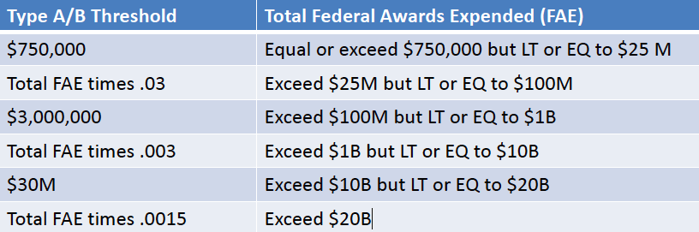
Type A/B Threshold- Table (200.518 (b)(1))
M means Million Dollars and B means Billion Dollars. LT means Less Than. EQ means Equal To.

Slide 51
High Risk Type A Program (200.518 (c)
(Step 2)
Current A-133 criteria:
Not audited as major program in 1 of 2 most recent audit periods.
  In most recent period had ANY AUDIT FINDING. Provided for auditor judgment in limited cases, e.g., very small questioned costs.
  Other – Auditor judgment
- Oversight exercised by Federal agencies or pass-through entities, audit follow-up, or changes in personnel or systems which significantly increased risk.
Uniform Guidance:
SAME.
  In most recent period had a HIGH- RISK AUDIT FINDING: Modified opinion.
  Material weakness in internal control.
  Known or likely questioned costs exceeding 5% of total program expenditures.
    Other – Auditor judgment. Removed inherent risk
    Otherwise basically same.
Key- An entity with strong internal controls and few audit findings will have less high-risk Type A program.

Slide 52
High-Risk Type B Program (200.518(d)) (Step 3)
Current A-133 criteria:
  Currently there are two Type B risk assessment options: Option 1 – Perform risk assessments on ALL Type B programs and select at least 50% of Type B programs identified as high risk up to number of low-risk Type A programs
  Option 2 – Perform risk assessments on all Type B programs until as many high-risk Type B programs have been identified as there are low-risk Type A programs.
New criteria:
Perform risk assessments on Type B programs until high-risk Type B programs have been identified UP TO at least 25% of number of low-risk Type A programs

Slide 53
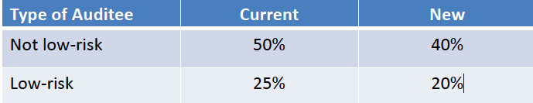
Percentage of Coverage Rule (200.518(f))
(Step 4)
Guidance reduces the minimum coverage as follows:

Slide 54
Low Risk Auditee (200.520)
Current (2 prior years)
Annual single audits
Unmodified opinion on financial statements in accordance with GAAP
Unmodified SEFA in relation to opinion.
No GAGAS material weaknesses
  In either of preceding two years, none of Type A programs had: Material Weakness.
  Material noncompliance.
  Questioned costs that exceed 5%.
Timely filing with FAC.
Auditor reporting going concern not preclude low-risk.
Waivers.
New (2 prior years)
SAME.
Unmodified opinions on statements in accordance with GAAP or basis of accounting required by state law.
SAME.
SAME.
SAME.
SAME.
No Audit reporting of going concern.
No waivers.

Slide 55
Single Audit Report Submission
200.512 Report Submission requires publication of Single Audit Reports online with safeguards for protected personally identifiable information and an exception for Indian tribes in order to reduce the administrative burden on non-Federal entities associated with transmitting these reports to all interested parties

Slide 56
Single Audit Reports on the Web
All auditees must submit the reporting package and the DCF electronically to the FAC.
•FAC submission process will be changed to require text-based PDF and unlocked, unencrypted.
•FAC responsible to make the reports publically available on a website: Exception for Indian tribes.
•Auditors and auditees must ensure reports not include Protected Personally Identifiable Information (PPII); Auditee must sign certification statement (to be revised on DCF) that reporting package does not include PPII

Slide 57
Additional Audit Related Comments
SEFA- Notes must indicate whether or not the entity elected to use the 10% de minimus cost rate
Findings- Whether a repeat finding or not from prior year
Questioned costs- the threshold is increased from $10K to $25K
  Known questioned cost > $25K
  Likely questioned costs > $25K
Summary schedule of prior year findings must also include findings related to the financial audit
Corrective action plan must be in a separate document
Notes:
Findings- If a repeat finding, must indicate prior year’s finding #.
Questioned costs- Must state how calculated and must be identified by CFDA# and Federal award#.

Slide 58
FAC Repository of Record Reporting Packages (200.36 & 200.512 (b))
Federal agencies, pass-through entities, and others obtain copies by accessing FAC website.
Subrecipient only required to submit report to FAC and no longer required to submit to pass-through entity.
•Pass-through entity no longer required to retain copy of subrecipient report as available on the Web.

Slide 59
2015 Compliance Supplement
Transition to Uniform Guidance
Implementation guidance.
Part 3 – 14 Types of Compliance Requirements: Awards under current circulars.
Awards under Uniform Guidance.
Part 6 – Internal Controls (2016 Supplement).
Appendix III – Federal agency contacts.
Appendix VI – Program specific audit guides.
Appendix VII – Other OMB Advisories: Loan and loan guarantee provisions now in UG.
ARRA may be removed.

Slide 60
GENERAL INFORMATION
Gran T Reform-Super Circular
General Information

Slide 61
Consolidated Website
System for Award Management
  One Stop Shop for contractors and grantees
  Contractor Registration website
  Debarment List
  CFDA moving here

Slide 62
Sources for Funding Opportunities
www.FedBizOpps.gov - BAA
www.Grants.gov
www.fedconnect.net
Agency Websites
  http://e-center.doe.gov/
  http://nsf.gov/funding/
  http://www.darpa.mil/funding_opportunities.html
  http://www.fta.dot.gov/funding/grants_financing_7829.html
Federal Register- NOFA
USASpending.gov

Slide 63
CAROI
Corporative Audit Resolution & Oversight Initiative

Slide 64
CAROI
Both the office of Inspector General (OIG) and the Equal Employment Opportunity Commission (EEOC) conducted a pilot program called the Cooperative Audit Resolution & Oversight Initiative (CAROI).
Goal: To improve resolution of recommendations contained in reports that require audit follow up.
Cooperative Audit Resolution (6 CAROI Principles)
  Means use audit follow up to techniques which promotes prompt corrective action by improving:
    Improve Audit Resolution
    Improve Communication
    Foster Collaboration
    Promote Trust
    Develop Federal & Non Federal Agency Understanding

Slide 65
CAROI
Corporative Audit Resolution & Oversight Initiative
Focus on program current conditions & corrective action (CA) going forward.
Releif for past non-compliances when audit shows prompt C/A
Federal agency leadership sending clear message to correct conditions identified which can cause: waste, fraud or abuse are unaceptable.

Slide 66
Federal Agency Responsibilities (200.513)
Use CAROI to improve outcomes
  Audit Resolution
  Follow Up
  Corrective Action
Management Decision
  Audit findings sustained or not
  Reasons for decisions
  Expected Action or Repayment
  Appeal Avoidable
  6 months of filing with Federal Audit Clearing House (FACH)

